Slide 1
Airframes, Engines and Systems
Sean Tyrrell

Slide 2
Written Exam
Private
  https://www.tc.gc.ca/eng/civilaviation/publications/tp12880-aeronautics-menu-101.htm
Commercial
  https://www.tc.gc.ca/eng/civilaviation/publications/tp12881-section4-1267.htm

Slide 3
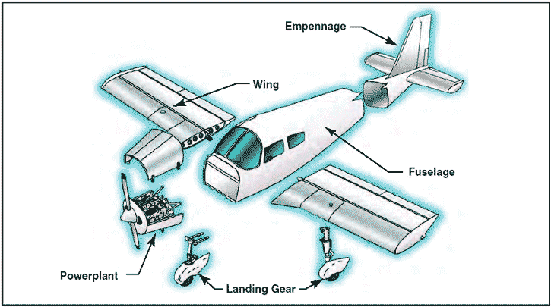
Airframe

Slide 4
Airframe
Airframe – complete structure of the aircraft
  Includes – fuel tanks and fuel lines, fuselage, wings, tail and undercarriage
  Does not include – instruments and engine

Slide 5
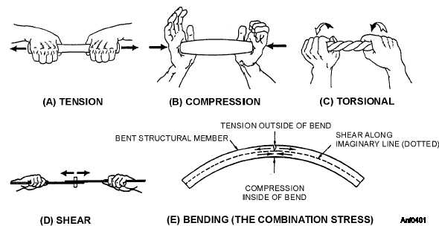
Airframes
Must withstand the following stresses:

Slide 6
Airframes
Metal Fatigue
  pressurization
Corrosion
  Corrosion is a chemical reaction
  Oxidation
  Intercrystalline
    Dissimilar metal
    Corrosion Fatigue

Slide 7
Fuselage
Fuselage
  The “foundation” of an airframe

Slide 8
Fuselage
Fuselage
  The “foundation” of an airframe

Slide 9
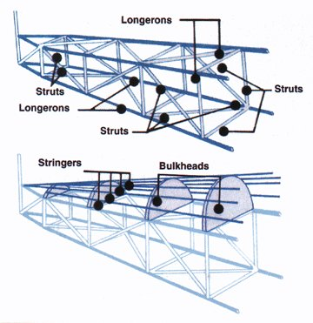
Truss Type Fuselage
Truss Type Fuselage
  The truss is responsible for handling all of the loads acting on the aircraft
  Longerons run lengthwise, braced together by struts
  Traditional style of aircraft construction
    Wood in the past, manufactured from steel tubes now

Slide 10
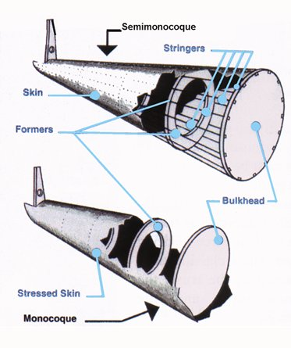
Semi-Monocoque Fuselage
Usual method of constructing aluminum aircraft
Consists of a frame in which aluminum skin attached with rivets or adhesives
Skin of the aircraft handles some of the load – hence the name “stressed skin”
Cessna 172 are constructed in this manner, as well as present day Boeing and Airbus models
Stringers act to hold everything together and the formers/bulkheads help carry the load

Slide 11
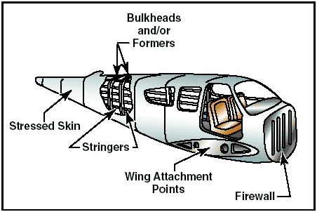
Semi-Monocoque

Slide 12
Monocoque Fuselage
Where the skin of the aircraft handles the load
Commonly found on newer small GA aircraft
Usually uses composite materials

Slide 13
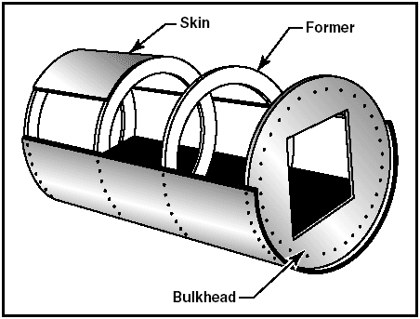
Monocoque

Slide 14
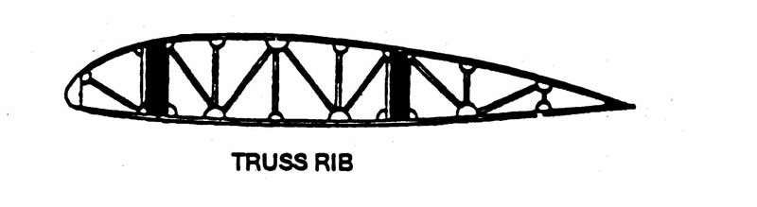
Types of Wing Structures
Truss Rib
  Truss type design similar to fuselage
  Truss carries the load
  Usually is wood and covered with fabric

Slide 15
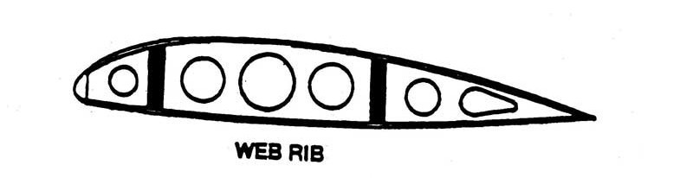
Types of Wing Structures
Web Rib
  “semi-monocoque”
  Modern design – present in our aircraft
  Skin takes part of the load
  Holes in the rib make the wing lighter, and provide passages for electrics and control cables

Slide 16
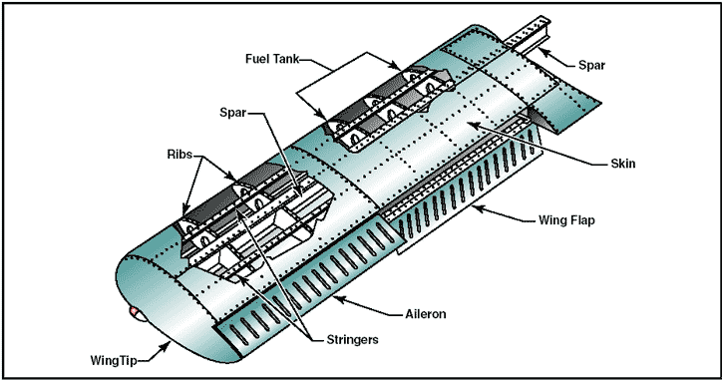
Types of Wing Structures

Slide 17
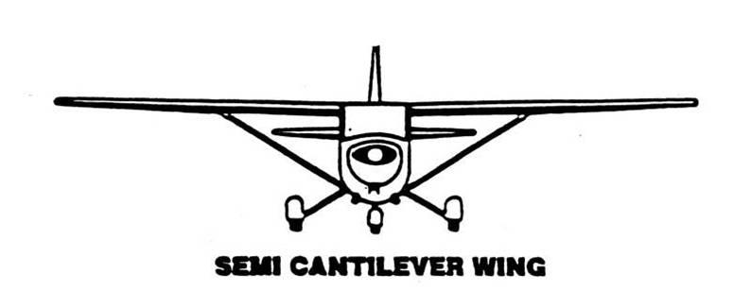
Wings
Semi-Cantilever Wing
  Wings are supported by wing struts
    Allow more headroom – Cessna Cardinal (Full Cantilever design, no struts but high wing)
    Easier to repair
    Visibility less, drag greater due to struts
  Cessna 172
    Has two spars running through the wings, wings supported by struts

Slide 18
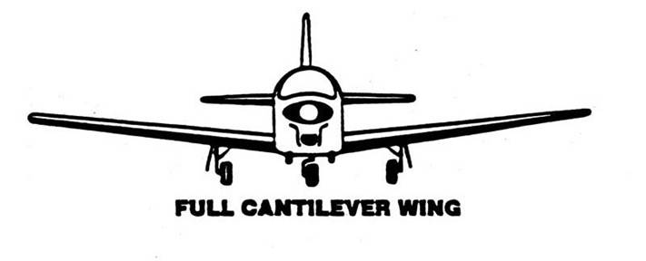
Wings
Full Cantilever Wing
  Wings are supported by wing spars
  Piper Seminole, low wing aircraft
    Visibility better, less drag
    More difficult repairs
    Spars intrude through cabin (under seats though)

Slide 19
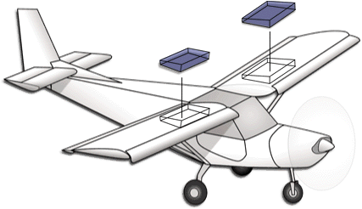
Types of Wing Structures
Wing Tanks
  Rigid Removable
    -removable compartments
  Bladder
    - reinforced rubber
  Integral
    - a portion of the wing is sealed to contain fuel
    “wet wing”

Slide 20
Firewall
Used to protect the occupants of the aircraft from fire from the engine
Located between the passenger cabin and the engine
Fuel is behind the firewall, oil is contained ahead of the firewall with the engine
Passages for line and wires, and air vents
  Note – this is why we close the vents if an engine fire – having smoke and flames inside the cabin isn’t good!

Slide 21
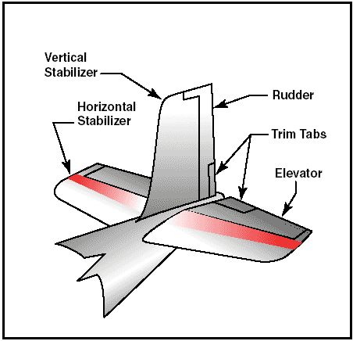
Tail
Tail or Empennage

Slide 22
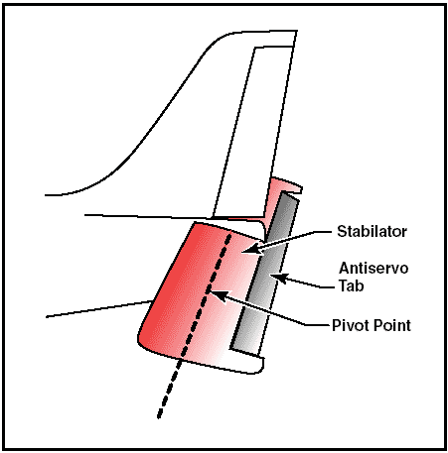
Stabilator
A single aerofoil that replaces the horizontal stabilizer and elevator
Gives more elevator authority - used primarily in supersonic aircraft to counteract shockwaves that could lead to loss of control

Slide 23
Exam Question?
Ice and snow on the critical surfaces (wings, control surfaces) can reduce lift as much as 30% and increase drag as much as 40%

Slide 24
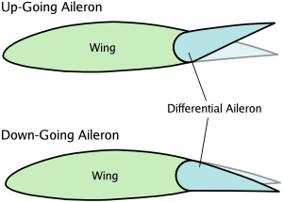
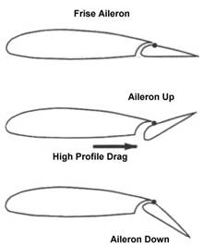
Control Surfaces
Ailerons
  Gives roll control
  172 use a mechanical system of cables and pulleys
  They also use a combination of differential and frise ailerons
  Roll spoilers?
  What direction do the ailerons move when we roll to the left? Right?
    How does this occur aerodynamically? Why do we get adverse yaw?

Slide 25
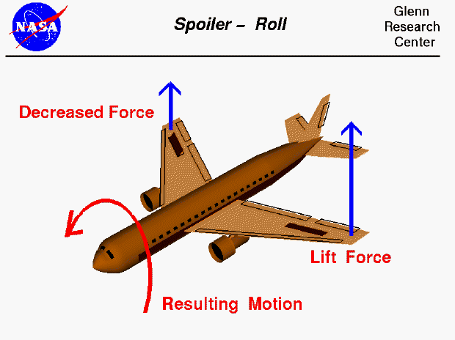
Roll spoiler

Slide 26
Control Surfaces
Elevators
  Gives pitch control
  172 use a mechanical system of cables and pulleys
  Aerodynamically what is occurring to cause pitch?

Slide 27
Control Surfaces
Rudder
  Used to maintain coordinated flight - yaw
  Once again…cable and pulley controlled
  Pedals are also used to steer the aircraft on the ground
    Does the nose wheel move when you depress the rudder pedals in flight?

Slide 28
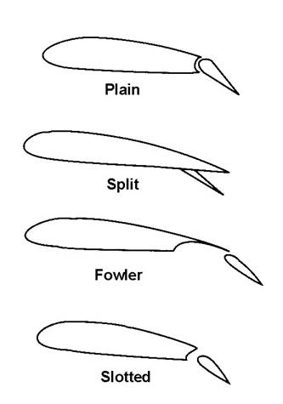
Control Surfaces
Flaps
172 – operated by cables and pulleys via an electric motor in the right wing of the aircraft
  Our aircraft have slotted-fowler flaps
    Slots allow airflow to continue over the flap as well – generate lift
    Fowler allows the flap to increase wing area as well as lift

Slide 29
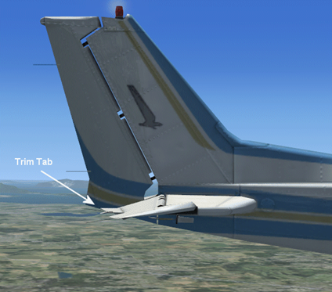
Control Surfaces
Trim
  A smaller, separate control surface attached to another control surface that is used to relieve the load caused by airflow
  Can be located on rudders, elevators and ailerons
  Operated by cables and pulleys
  some models of 172 has rudder trim as well – however it is not a true trim as there is no separate control surface on the rudder (all the trim does is move the cable position slightly to hold the controls)

Slide 30
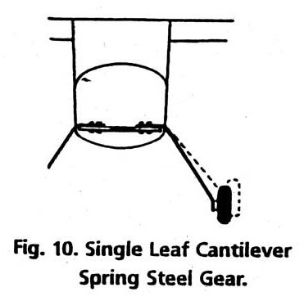
Landing Gear
Single Leaf Cantilever Spring Steel
  172’s have this
  Strong, durable, simple and relatively cushioning

Slide 31
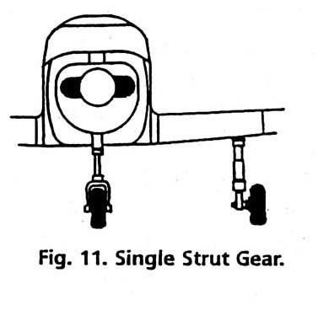
Landing Gear
Single Strut
  Present on the nose wheel of the 172
  Low wing aircraft use this type
  Where are the wheels attached to? Spar
  Cushion well, but are somewhat less capable of taking abuses

Slide 32
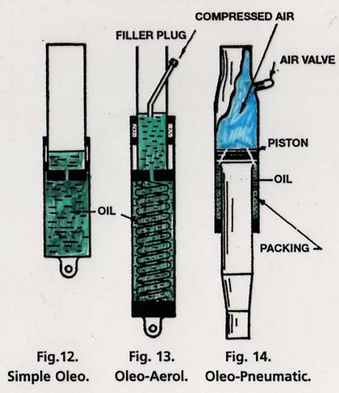
Landing Gear
Oleos
  Oil is better at absorbing initial shock from landing
  Nitrogen or spring is used for keeping nose up and absorbing bumps on ground

Slide 33
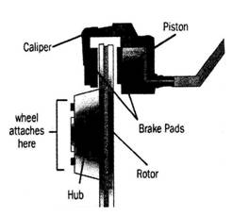
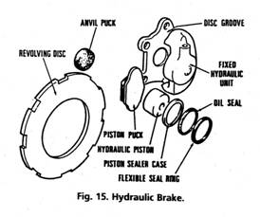
Brake System
What kind of braking system do we have?
  Independent/differential braking
  Hydraulically operated
Where is the master cylinders located?
  Behind the left seat pedals

Slide 34
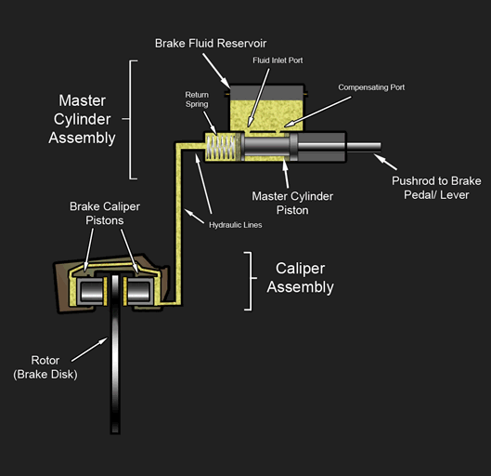

Slide 35
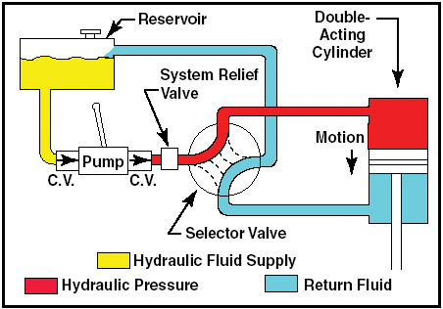
Brakes/Hydraulics

Slide 36
Nose Wheel VS Tail Wheel
Nose | Tail
-good visibility taxiing -easier to control on TO and LA -ground loop tendency reduced -easier to taxi -easier to handle in a crosswind | -lighter -less drag -ok to lose a tail wheel -better for rough ground -better prop clearance -easier to ground handle (move by hand) -wind can sweep tail wheel easily -no weight over tail

Slide 37
Propellers
Pitch
  Theoretical/Geometric
    The distance the prop should move through the air theoretical
  Practical/Effective
    Distance the prop actually travels through the air
  Propeller Slip
    difference between theoretical and effective pitch

Slide 38
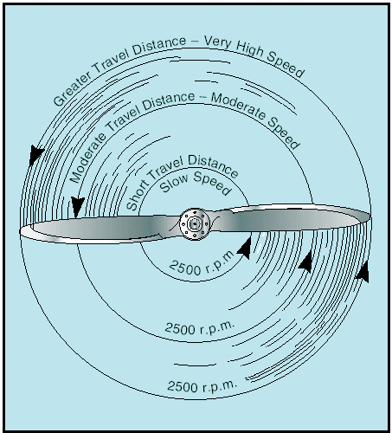
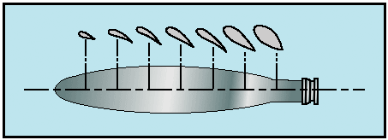
Propellers

Slide 39
Propellers
Fixed Pitch
  Blade angle cannot be changed
  Simple, usually pitch is chosen on application of aircraft, desired performance (climb or cruise) or a balance of both
  A more coarse pitch (greater bite) is better for higher cruise speeds, a more fine pitch (less bite) is better for quicker climbs

Slide 40
Propellers
Adjustable Pitch
  This kind of prop can be adjusted on the ground only by an AME

Slide 41
Propellers
Constant Speed
  Blades will automatically adjust pitch in order to hold a constant RPM as set by the pilot
    RPM is set by prop control, throttle is adjusted to control engine power output (manifold pressure)
  Contains a governor, which uses a system of oil pressure, counterweights and springs in order to maintain the desired RPM
    The governor senses the changing RPM of the prop, and varies oil pressure in order to change prop pitch in order to hold RPM
    There are some governor systems that are electrically based to do the same thing as the oil pressure does – systems using oil pressure are more common

Slide 42
Propellers
  If engine fails, prop can be placed into feather (very coarse pitch)(twin engine only), so that air flows freely past the blades and causes less drag (some aircraft have auto feather systems)
  Can be used to select a high RPM for takeoff (fine pitch) for best climb performance, or hold a lower RPM (more coarse pitch) during cruise flight

Slide 43
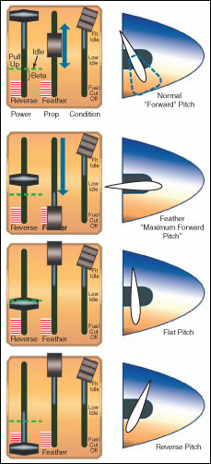
Beta Range
  Area of zero pitch (very fine or flat) in order to take little or no bite out of the air
    - used to slow aircraft on landing, used often during taxi as any pitch on a turboprop can cause it to speed up quickly (turbine engines idle at quite a high speed)
    - also called “ground range” or “ground fine”
    - throttle controls prop pitch (beta valve)

Slide 44
Propellers
Reverse
  Prop pitch can be placed in a negative pitch, causing the props to actually push air forward to slow the plane on landing
  What prevents the prop from going into reverse during flight?

Slide 45
Propellers
Prop pitch
  Alpha – forward, positive angle of pitch
  Beta – zero pitch
  Reverse – negative pitch

Slide 46
Engines
Provides power for motion and drives electrical, pneumatic (vacuum) and hydraulic systems
Indicated horsepower – theoretical power capability of the engine. ie: actual cylinder pressure
Brake horsepower – actual power measured at the crankshaft
  This is minus losses from friction in the engine
  IHP-FHP=BHP

Slide 47

Engines
Torque- tendency of a force to rotate an object around it’s axis
Involved in the measurement of BHP
  lbs/feet
  Prony brake

Slide 48
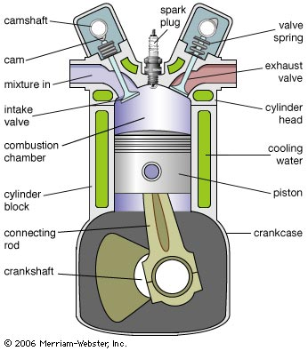
Four Stroke Engine

Slide 49
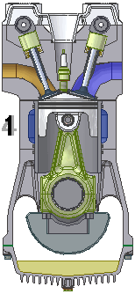
Four Stroke Engine

Slide 50
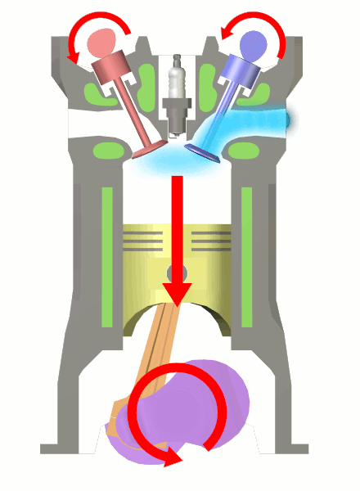
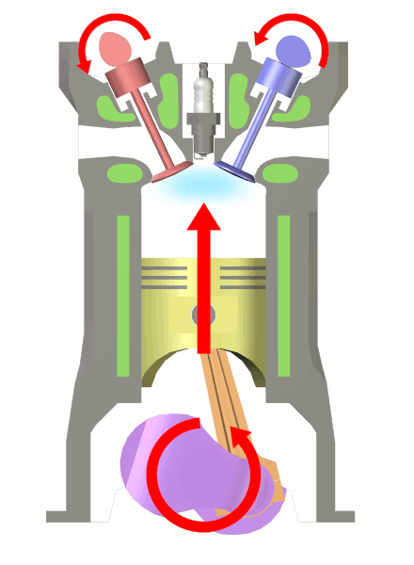
Four Stroke Engine

Slide 51
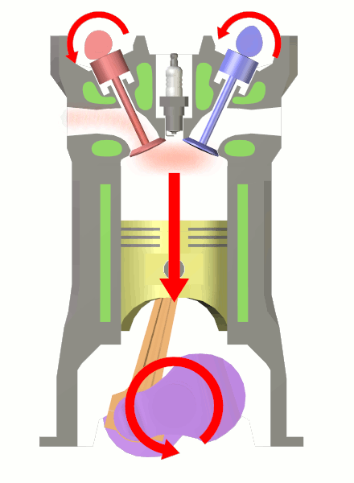
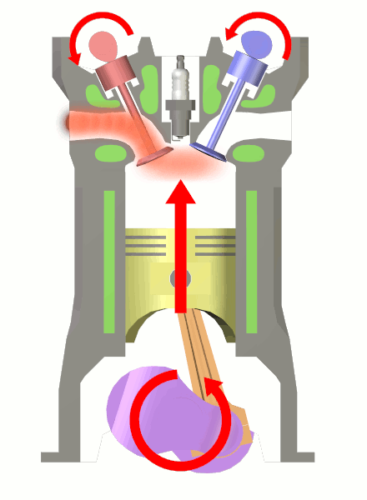
Four Stroke Engine

Slide 52
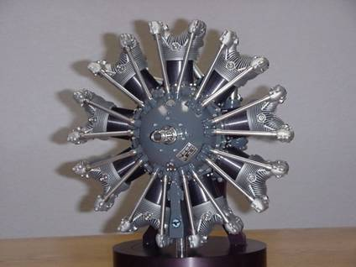
Engines
3 main types of reciprocating engines in aviation
  Radial
  Odd number of cylinders
    Benefits
      Relatively simple to maintain
      Cooled by air well
    Downsides
      Consumes a lot of oil
      Visibility is not great
      Not very streamlined

Slide 53
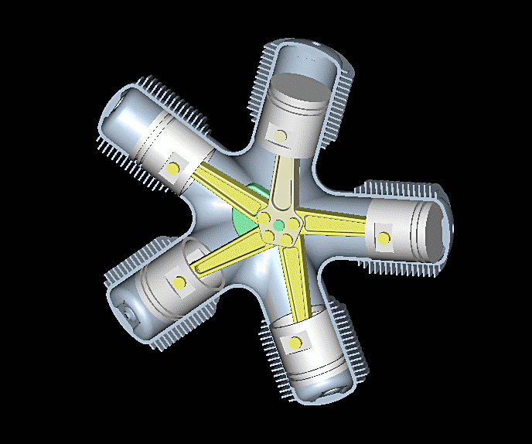
Radial Engine

Slide 54
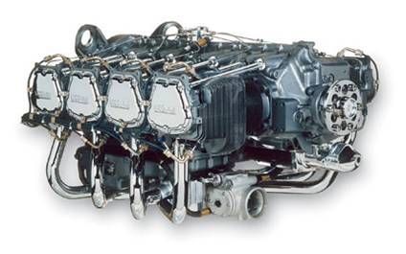
Horizontally Opposed Engine
Horizontally Opposed
  Benefits
    Compact
    Relatively good to air cool
  Downsides
    Larger engines, back cylinders sometimes can be hard to cool by air

Slide 55
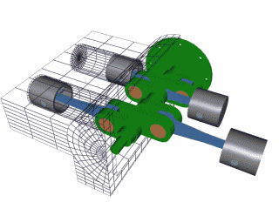
Horizontally Opposed Engine

Slide 56
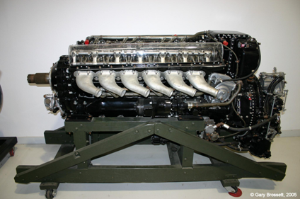
V Engine
V
  Not common in modern aircraft
  Benefits
    Relatively compact for the amount of cylinders
  Downsides
    Air cooling difficult if not impossible

Slide 57
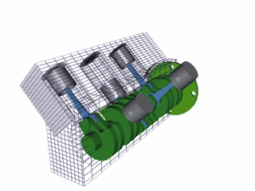
V Engine

Slide 58
Engines
C-172S Lycoming 180@2700 RPM 360 cu inches 8 Q of oil Max. temp 118C/245F Oil pressure 20/115 PSI | C-172P Lycoming 160@2700 RPM 320 cu inches 8 Q of oil Max. temp 118C/245F Oil pressure 25/115 PSA
Normally aspirated, 4 cylinder, 4 stroke, horizontally opposed engines with 8 spark plugs and 8 valves

Slide 59
Two Stroke Engine
Only usually found in smaller aircraft
  Ultralights
  Advantage
    Greater power to weight ratio
    Simpler, cheaper to manufacture
  Disadvantages
    Wears out more quickly – no dedicated oiling system
    Less environmentally friendly – burns oil as part of the fuel mixture
    Less fuel efficient

Slide 60
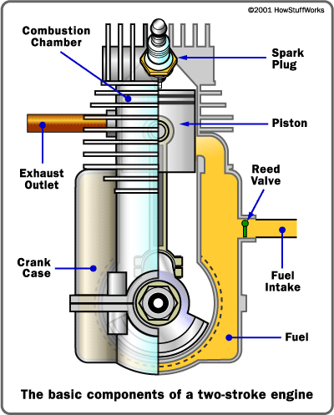
Two Stroke Engine

Slide 61
Diesel Engine
The only inherent difference between a four stroke and a diesel are as follows
  Diesel does not have spark plugs
    Diesel engines use higher levels of compression to ignite the fuel/air mixture rather than spark plugs in a regular engine
http://auto.howstuffworks.com/diesel1.htm

Slide 62
Air-Fuel Ratio
What is the normal fuel-air ratio?
  1:14.7
  This is fuel-air ratio by weight
What happens to air density due to altitude and humidity?

Slide 63
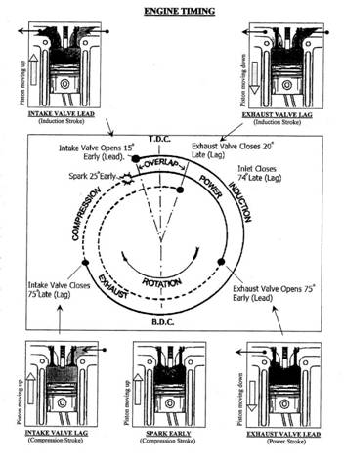
Engine Timing

Slide 64
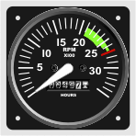
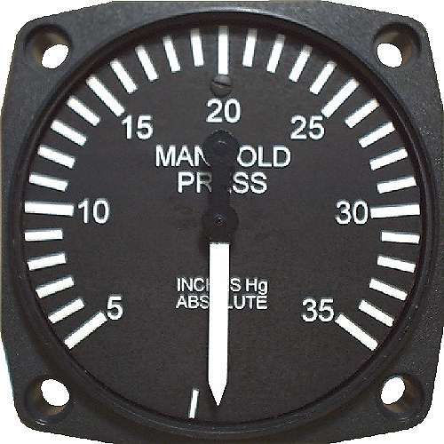
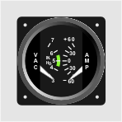
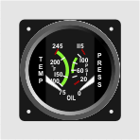
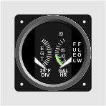
Engine Instruments

Slide 65
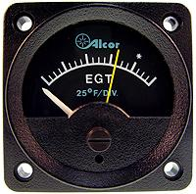
Engine Instruments
EGT
  Measures temp of exhaust gases – this model only shows those off the hottest running cylinder – rearmost
  Use?
    Lean until peak temp
    Continuing to lean will see a decrease from the peak
    Enrich mixture until you see a 25° F drop from peak
    The yellow moveable needle is intended to act as a marker for peak EGT

Slide 66
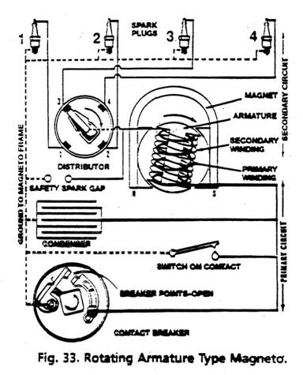
Ignition System

Slide 67

Magnetos

Slide 68
Cooling
Types?
  Air or Water cooled

Slide 69

Cooling

Slide 70

Cooling

Slide 71
Cooling
Ways to cool engine
  Cowl Flaps
  Power Setting
  Fuel Mixture
  Airspeed
Thermal Shock
  certain engine parts cool faster than others

Slide 72


Carburetor

Slide 73

Carburetor

Slide 74
Carburetor
Mixture
  Too rich?
    Black smoke
    Unburned fuel – wasting fuel
    Fouls spark plugs
    Rough engine, loss of power, potential engine failure
  Too lean?
    Rough engine, backfiring
    Overheating of engine
    Loss of power, potential engine failure

Slide 75

Carburetor Ice

Slide 76

Carb Icing

Slide 77

Fuel Injection

Slide 78

Fuel Injection

Slide 79

Fuel injection C-172S

Slide 80

Turbocharging

Slide 81


Slide 82
Supercharging
Similar to turbocharging in that it assists the engine in having more dense air pressure at altitude
Difference is that the compressor is driven directly by the engine
  Advantage? Power changes do not experience any lag (turbo lag)
  Disadvantage? Will hamper power the engine develops since we are driving the compressor directly off the power the engine produces rather than the spent exhaust gases in a turbocharged engine

Slide 83
Air Density and Humidity
How does air density and humidity affect aircraft engine performance? Why?
Carb heat
  What happens to the mixture when you pull the carb heat hot?

Slide 84

Fuel Systems

Slide 85
Fuel
Fuel types?
Vapour lock
Contamination
  Water
  Fungal/bacterial growth
  Sediment

Slide 86

Fuel

Slide 87
Fuel
Pre-ignition
  Where the fuel/air mixture in the cylinder ignites before the spark plug fires
    Typically caused by hot spots in the cylinder
      Carbon deposits on cylinder the wall left over from combusted fuel retain heat
  Engine temperatures can rapidly increase causing engine damage

Slide 88
Fuel
Detonation
  Where the fuel/air mixture in the cylinder ignites after the spark plug fires
    Typically caused by excessive pressure in the cylinder
      too high power setting
      too lean mixture
      manifold pressure higher than RPM (constant speed)
      ambient pressure change (frontal passage)
      using too low of octane rating
  Excessive pressure can put immense strain on engine parts

Slide 89


Lubrication Systems

Slide 90

Lubrication Systems

Slide 91
Functions of Oil
Cooling
Sealing
Lubrication
Flushing

Slide 92
Requirements of Oil
Viscosity
High Flash Point
Low Pour Point
Low Carbon Content

Slide 93
Additives
Detergents
Oxidation Inhibitors
Anticorrosion
Pour Point Depressants

Slide 94

Electrical System

Slide 95

Electrical System

Slide 96
Electrical System
Generator/Alternator
  Both provide electrical power to charge the battery and provide additional power for systems
  Alternator is more often used in newer aircraft because they provide more power at low RPM’s
  Alternators VS Generators
    Alternators are more complex, but are able to charge batteries at engine idle, more reliable, able to provide greater amperages
    Generators – older technology – needs to be “polarized” before use in order to generate electricity – can lose this polarization if battery is completely dead
Master/Alternator/Generator Switch
Ammeter/Load Meter
Circuit Breakers/Fuses

Slide 97
Pressurization
Runs off of bleed air
  Bleed air is air that is taken from the compressor section of a turbine engine
    Cabin is usually pressurized to 8000 ft on most aircraft
      Any higher cabin altitude is too hard on crew and passengers, a lower altitude is simply too hard on the aircraft (pressure differential too great)
    This air is hot, but is cooled through a heat exchanger (bleed air passes over cold outside air) and then something called an air cycle machine in order to bring the air temperature to a comfortable level
    The hot bleed air is used in large aircraft to heat the leading edge of the wing as well as the engine intake to prevent icing (anti-icing)
      NOTE – de-icing is equipment that can only remove existing ice, not prevent it like anti-icing

Slide 98

Pressurization

Slide 99

Pressurization

Slide 100
Icing Systems
De-ice VS Anti-ice
  De-ice – will rid of ice that has already built up
    De-icing boots
  Anti-ice – will prevent the formation of ice
    Usually heated surfaces, liquid anti-icing systems

Slide 101

Icing Systems

Slide 102

Icing Systems

Slide 103

Icing Systems

